Slide 1
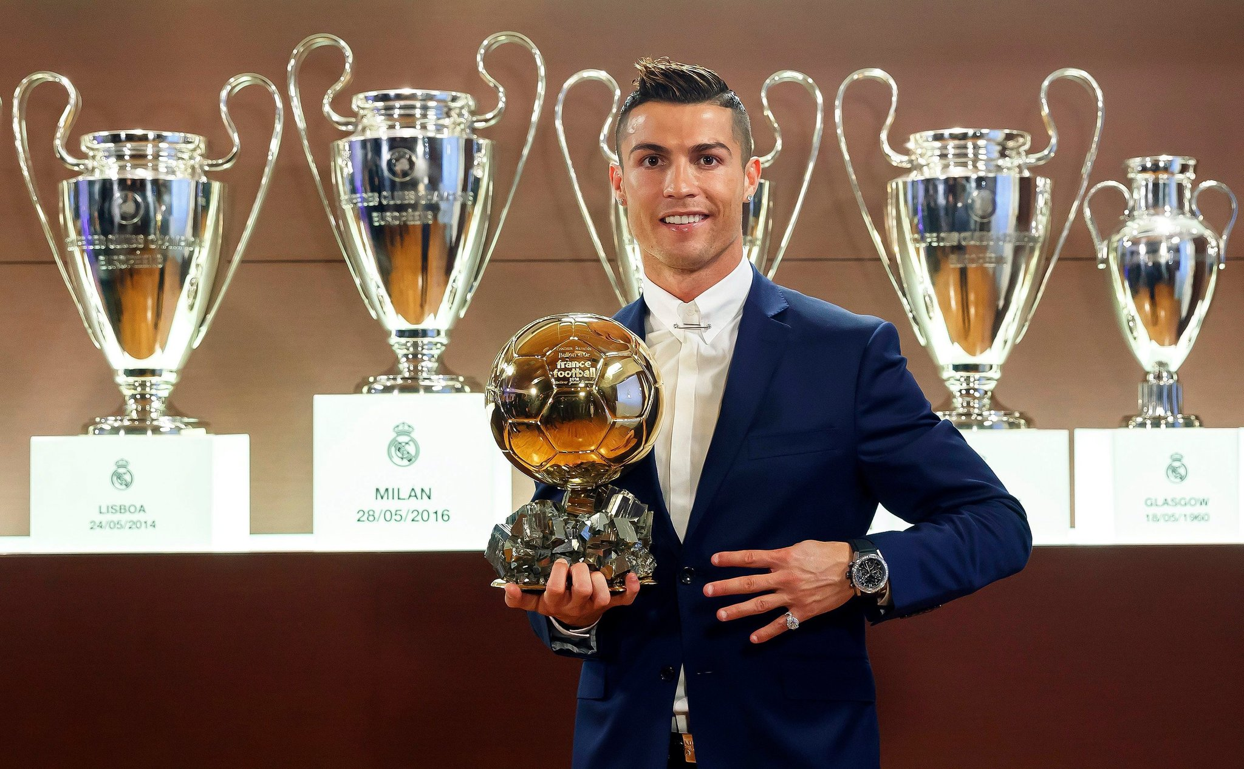
All about Ronaldo
Divyaansh

Slide 2
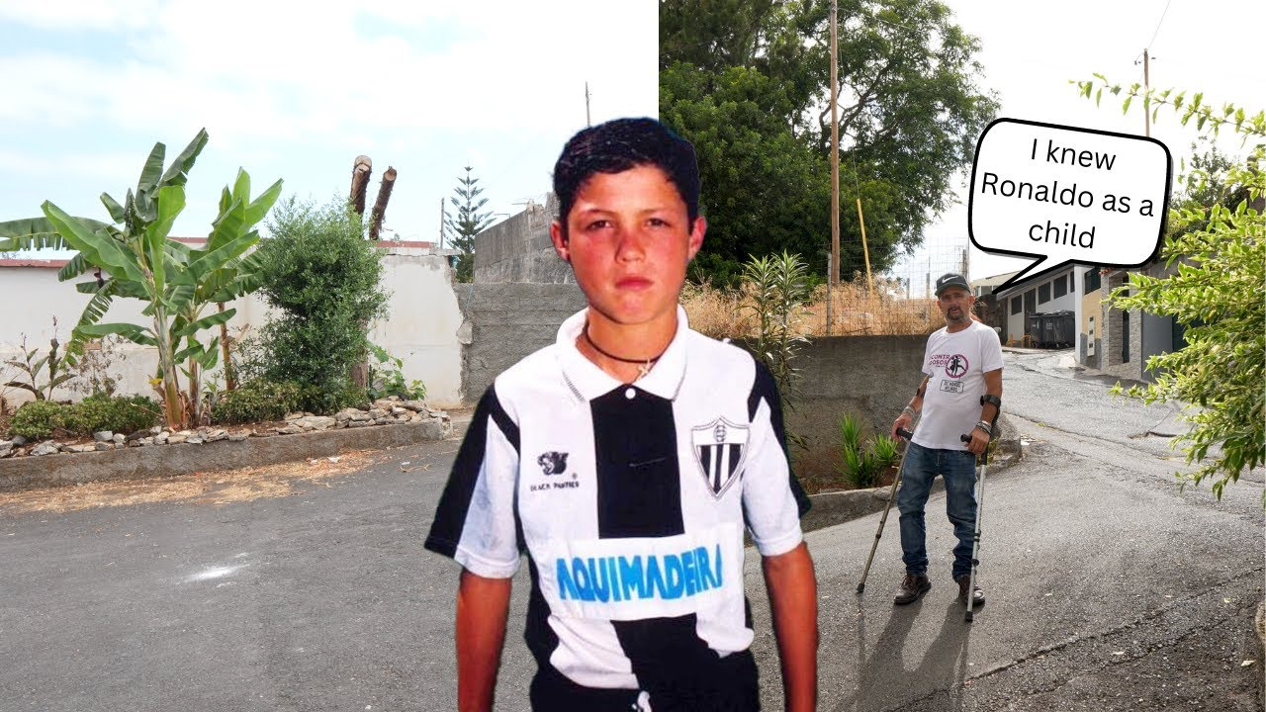
HOMETOWN/AGE
Ronaldo was born in Portugal, funchal he is born at (2/5/1985)

Slide 3
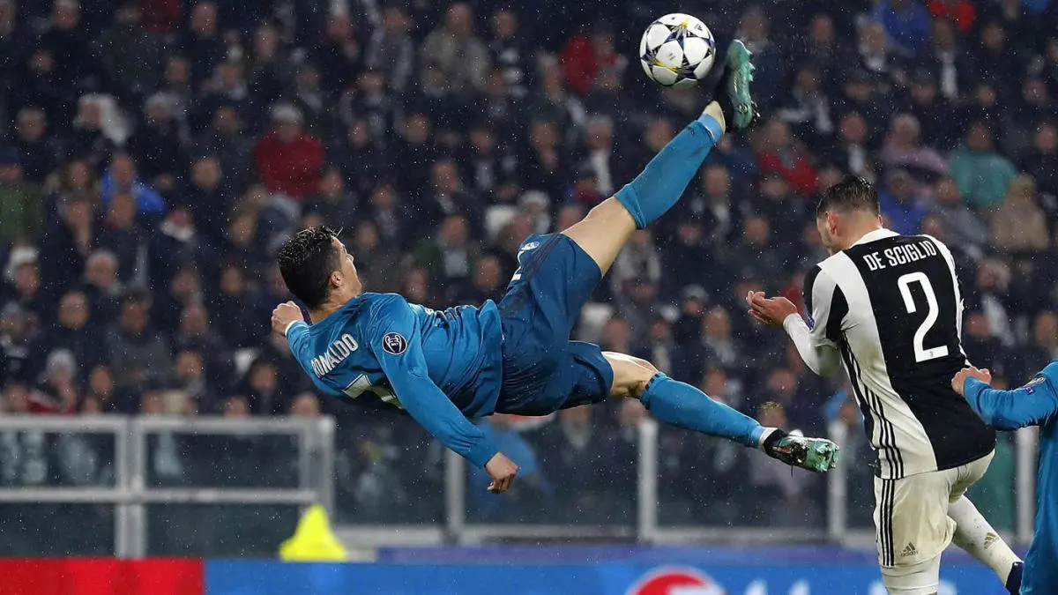
Profession
He is known for his goals and his legendary bicycle kick 2016!!!

Slide 4
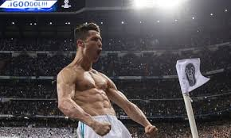
Creative entrepreneurs type
Ronaldo is a soccer player he has played for clubs like: Juventus, Real Madrid,Manchester united.

Slide 5
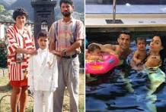
Inspires
This person inspires me from his story from penniless to billionaire !!!!!

